Slide 1
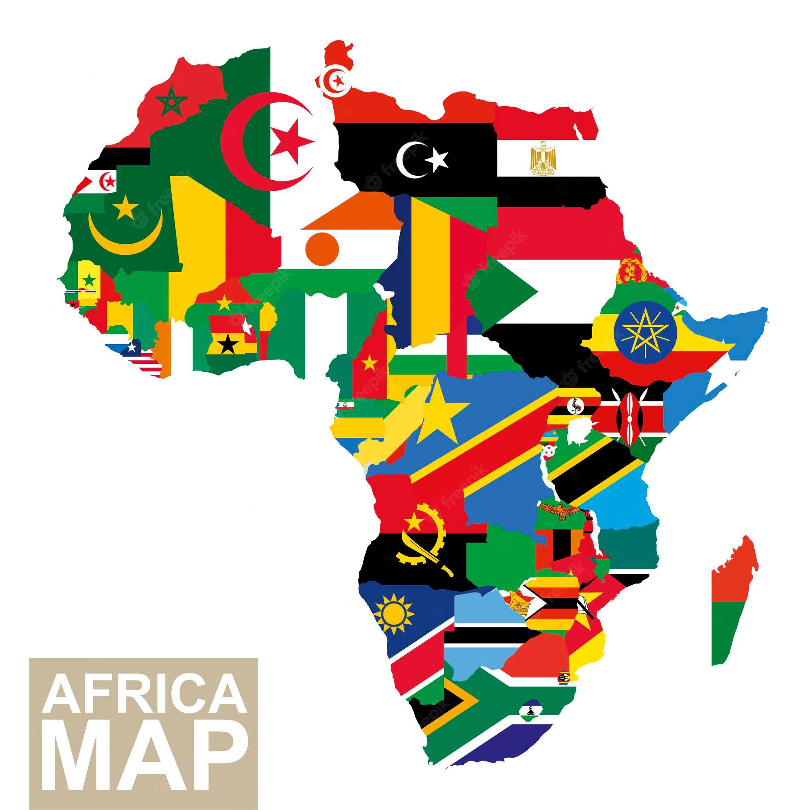
Maria Sousa Galito
Assistant Professor at the Lusiada University of Lisbon.
Researcher at the CEJEA of Lusíada University of Lisbon.
Researcher at the CESA-CSG of ISEG, University of Lisbon.

Slide 2
Coup d'état
AFRICA
What is a Coup d’état?
What are the dynamics, ideologies and intentions of a Coup d’état?
Impact on the International System?
Responses (or lack of) by the International society?
Conflict prevention dynamics;
Prospects for the future of the African continent.

Slide 3
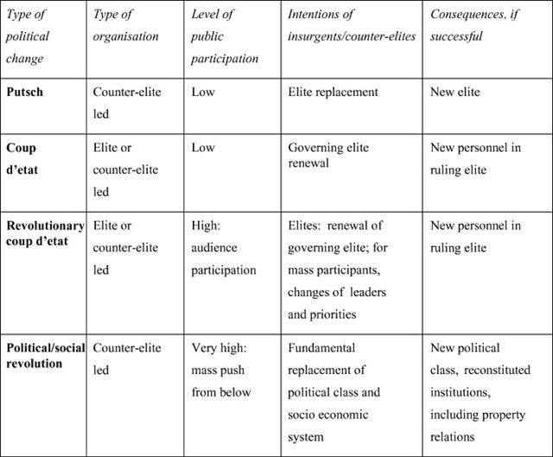
Political Change
Putsch: sublevação de um grupo político armado
«A putsch may be defined as a sudden illegitimate overthrow of a ruling elite by another competing elite (for example, the installation of a military regime in place of a political one).»
«A coup d’état is an illegitimate replacement or renewal of one governing set of personnel by another (e.g. the replacement of a ruling faction of a political party by another from that party or another party).» (Lane, 2008: 528-529)
David Lane, 2008: https://www.researchgate.net/publication/227617553_The_Orange_Revolution_%27People%27s_Revolution%27_or_Revolutionary_Coup

Slide 4
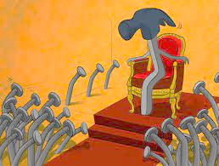
Coup d’état
Foreign Government’s violent overthrow.
The noun coup d'etat is useful for talking about revolutionary uprisings or military takeovers that result in a country's government changing hands very suddenly.
In English, the term is often coup d'etat shortened to just coup, and it has been used in English since the late 1700s.
Coup d'etat means strike against the state.
Most likely causes of a coup d’état?
An oppressive ruler or an unfair Government.

Slide 5
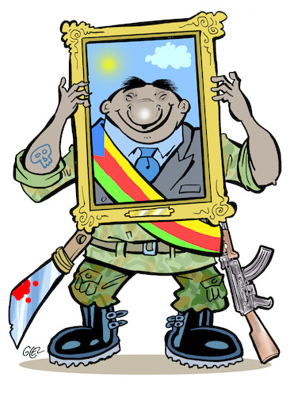
Military Coups
«The primary purpose of a military is to protect the state from external threats. To achieve that purpose, the state must endow the military with the means to use coercive power via military equipment and personnel. This ability to use coercive force, though necessary to defend the nation against threats, creates the danger that the military will turn its weapons on the very regime that empowered its existence.» (Ozan Varol, 2012: 295)
Harvard International Law Journal, vol. 53:
https://harvardilj.org/wp-content/uploads/sites/15/2012/10/HLI203.pdf
While popular uprisings are people-led, coup’s success is often determined by the decision taken by the military.

Slide 6
Military Coups
Democratic military coups commonly feature seven attributes (Ozan Varol, 2012: 295):
The military coup is staged against an authoritarian or totalitarian regime;
The military responds to popular opposition against that regime;
The authoritarian or totalitarian leader refuses to step down in response to the popular opposition;
The coup is staged by a military that is highly respected within the nation, ordinarily because of mandatory conscription;
The military executes the coup to overthrow the authoritarian or totalitarian regime;
The military facilitates free and fair elections within a short span of time;
The coup ends with the transfer of power to democratically elected leaders.
But
They may be staged against a democratically elected government (not an authoritarian or totalitarian regime);
They may result in a dictatorship (not in free and fair elections).
Harvard International Law Journal, vol. 53: https://harvardilj.org/wp-content/uploads/sites/15/2012/10/HLI203.pdf

Slide 7
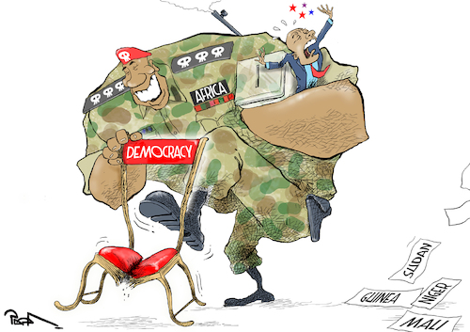
Military Coups
Following the Democratic military coups (Ozan Varol, 2012: 295):
The military temporarily governs the nation as part of an interim government until democratic elections of civilian leaders take place.
During that democratic transition process, which typically lasts for one to two years, the military must oversee a number of housekeeping tasks to transition the nation to a Democracy.
But
Before the end of Cold War “the vast majority of coups do not fit within the democratic coup framework”;
«According to a recent empirical study, in the post-Cold War era, 74% of coups were followed by democratic elections within 5 years.»
Harvard International Law Journal, vol. 53: https://harvardilj.org/wp-content/uploads/sites/15/2012/10/HLI203.pdf

Slide 8
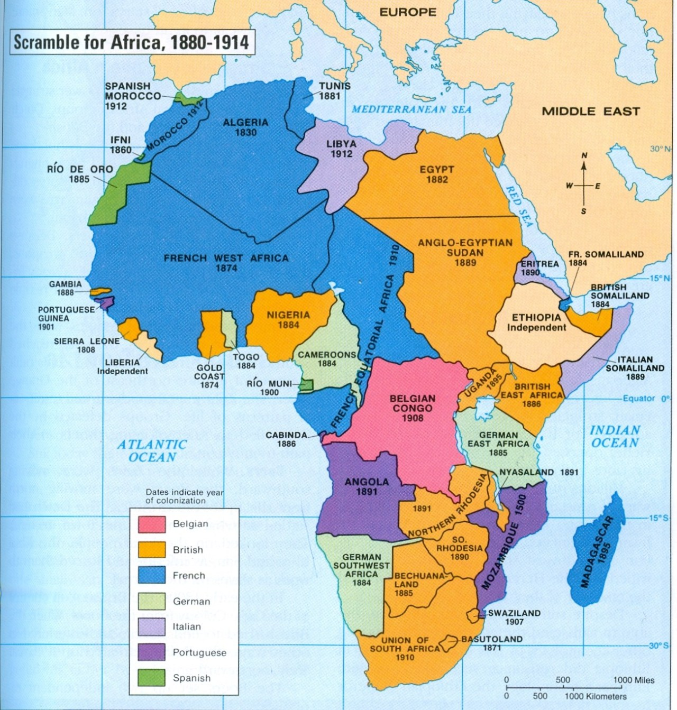
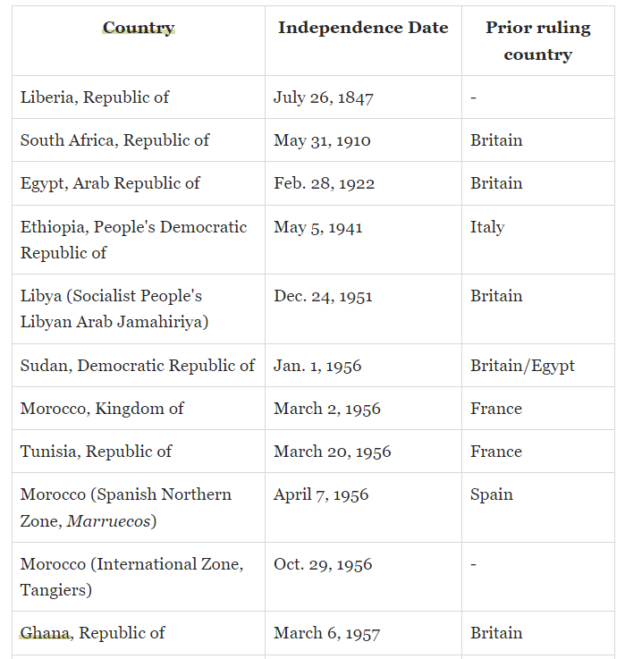
Berlin West Africa Conference: negotiations from November 1884 to February 1885 for European colonial expansion in Africa. Borders were designed considering foreign interests, not local ethnic divisions.
First Independences in Africa.
https://mapsontheweb.zoom-maps.com/post/55693707978/africas-colonization-by-european-empires
https://www.thoughtco.com/chronological-list-of-african-independence-4070467

Slide 9
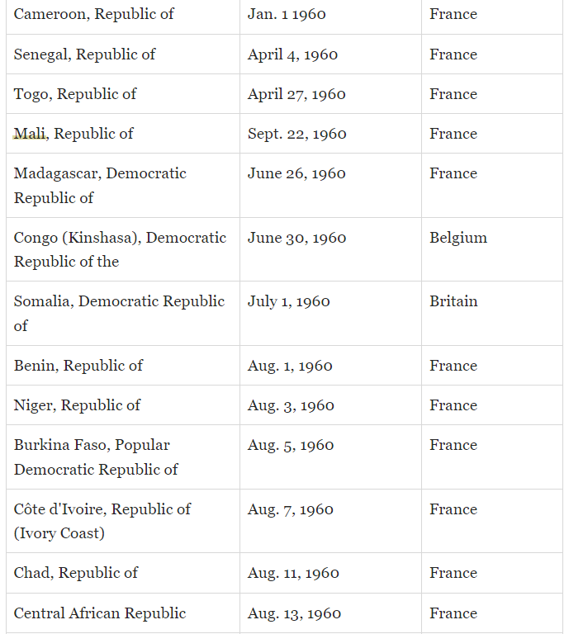
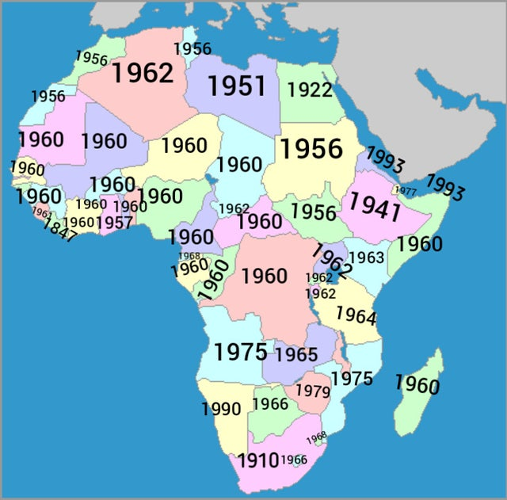
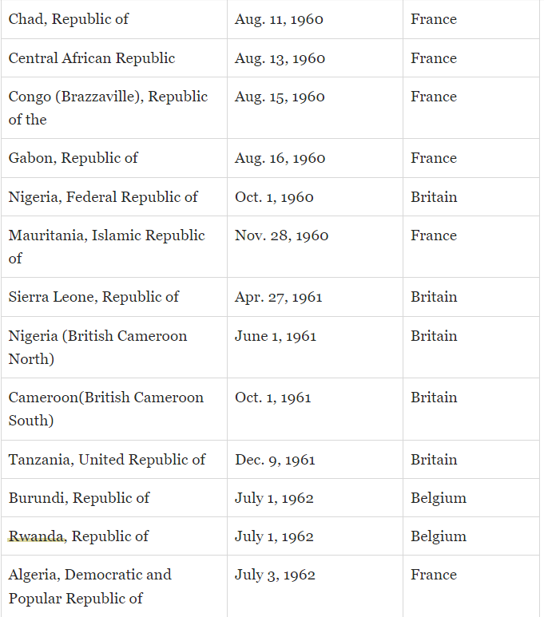
Independence of African Countries
1960
https://www.thoughtco.com/chronological-list-of-african-independence-4070467

Slide 10
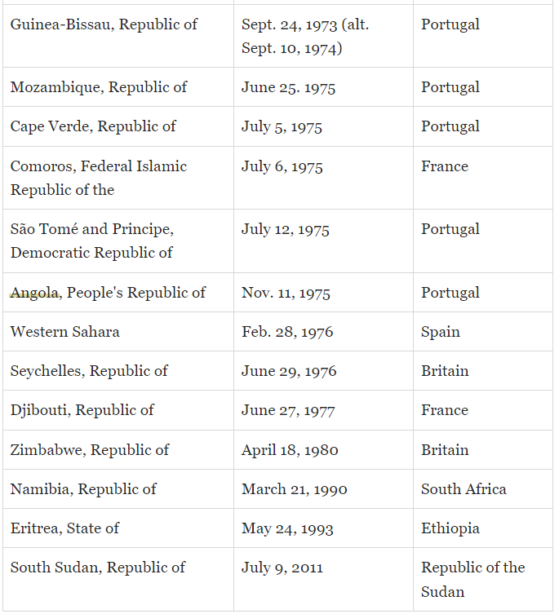
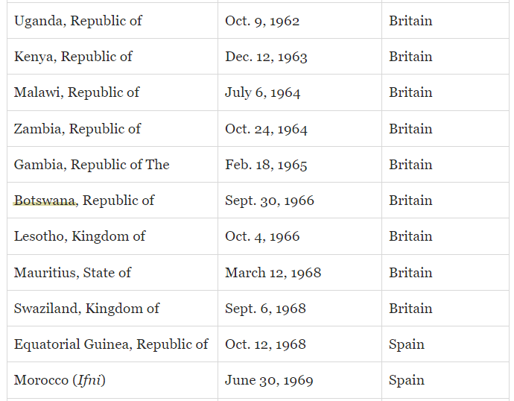
Independence of African Countries
https://www.thoughtco.com/chronological-list-of-african-independence-4070467

Slide 11
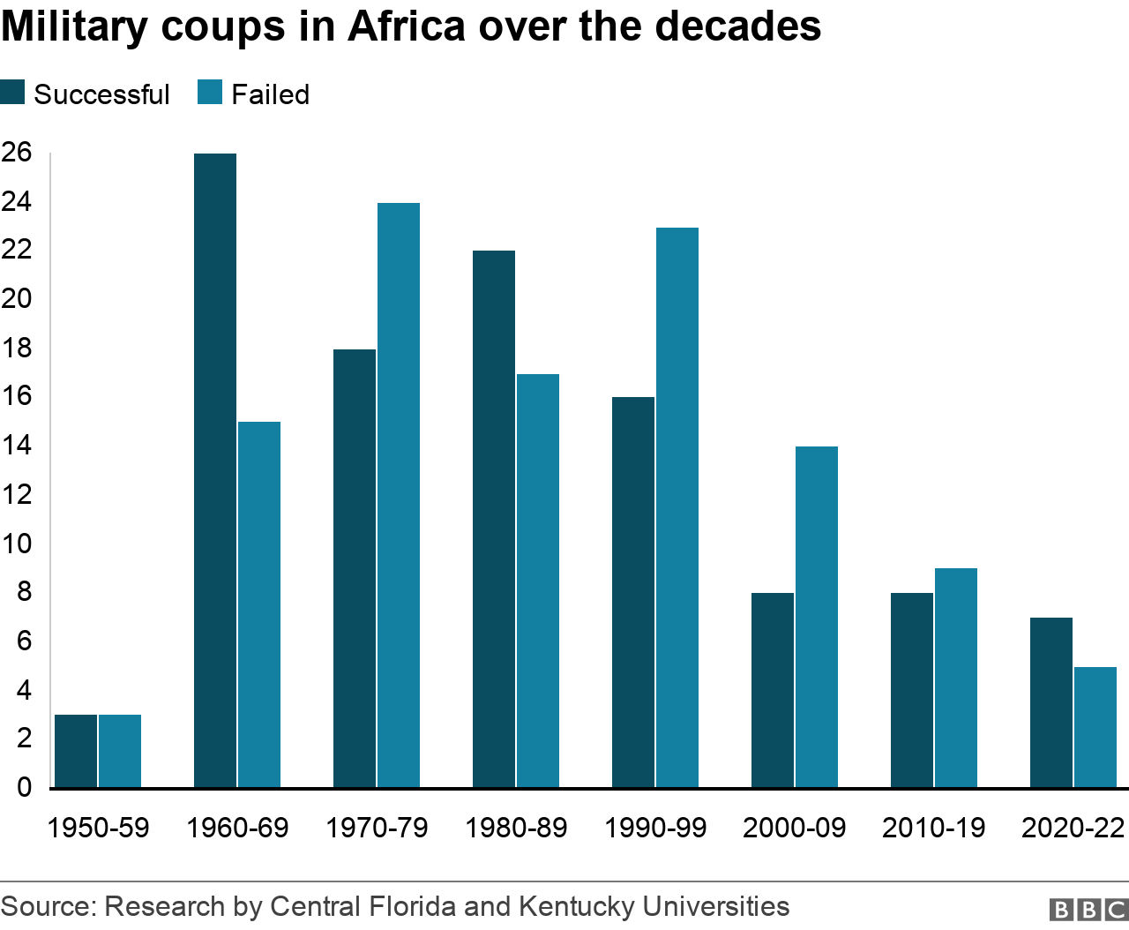
Military Coups in Africa
Less military coups before (most) independences in Africa. More in the 60’s. A lot between the 70´s and 90´s.
https://www.bbc.com/news/world-africa-46783600

Slide 12
AFRICA
Less military coups before (most) independences in Africa.
1960/2000: the overall number of coup attempts in Africa was about 4 a year in these 4 decades.
Coups dropped to around two a year in the two decades up to 2019.
In 2020 only one coup was reported (in Mali).
In 2021 there was a noticeably higher than average number: 6 coups or attempted coups were recorded. There were successful coups in Chad, Mali, Guinea and Sudan and failed military takeovers in Niger and Sudan.
2022: 5 attempts. Only two succeeded (in Burkina Faso).
https://www.bbc.com/news/world-africa-46783600

Slide 13
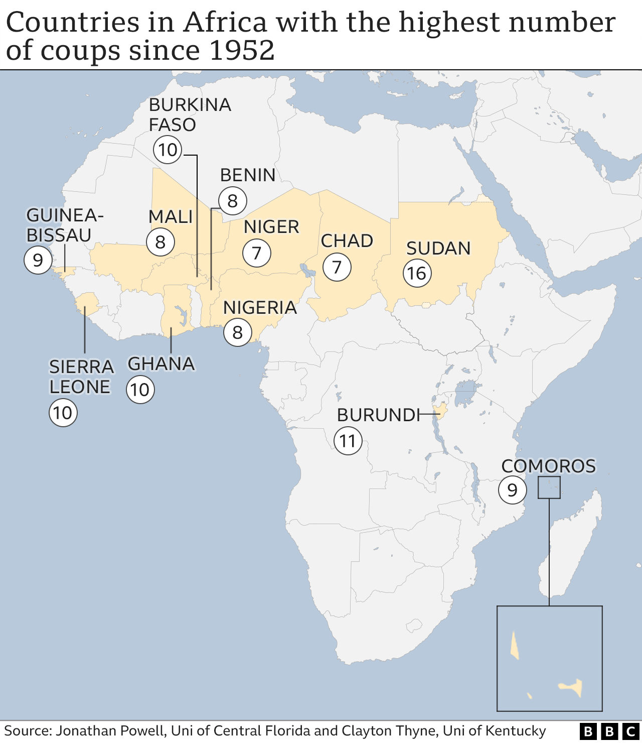
AFRICA
Sudan had the most coups and attempted takeovers: 16 (6 of them successful).
Nigeria had several military coups after independence, with 8 between January 1966 and the takeover by Gen Sani Abacha in 1993.
Burundi's history has been marked by 11 separate coups, mostly driven by the tensions between the Hutu and Tutsi communities.
Sierra Leone had 3 coups between 1967 and 1968, and another one in 1971. Between 1992 and 1997, it experienced five further coup attempts.
Ghana has also had its share of military coups, with 8 in two decades. The first was in 1966.
However, since 1999 transfers of power in Africa's most populous nation have been by democratic election.
https://www.bbc.com/news/world-africa-46783600

Slide 14
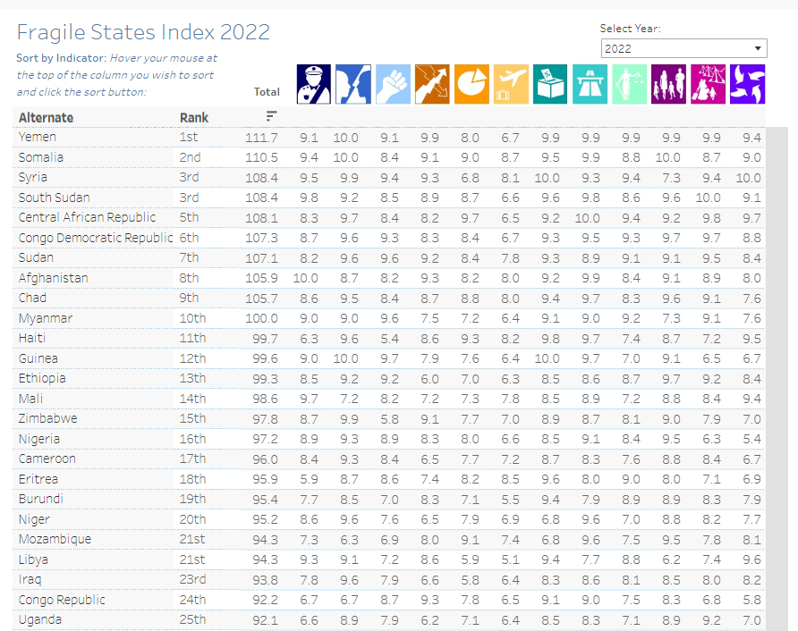
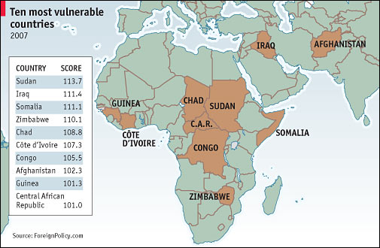
AFRICA Vulnerable States
https://fragilestatesindex.org/global-data/
https://www.economist.com/news/2007/06/19/sos

Slide 15
Military Coups in Africa
What are the dynamics, ideologies anda intentions of Military Coups in Africa?
Dynamics: high maintenance, self-motivated;
Strong persistency in the case off failed independences.
Unresolved issues, like vulnerable or unreliable borders.
Arab Spring and it’s consequences.
Power struggle between political or military leaders.
Power struggle between ethnic groups.
Impact on the International System? Low.
Potential causes?
Lack of Governance or political authoritarian regimes;
Regular Economic crisis (domestic and international).
Poverty. Most people in Africa are poor.
But elites are too rich and jealous of each other.
Different types of violence (Guerrilla, Terrorism, Trafficking).
Responses by the International society? Inadequate.
Prospects for the future of governance in Africa: difficult.

Slide 16
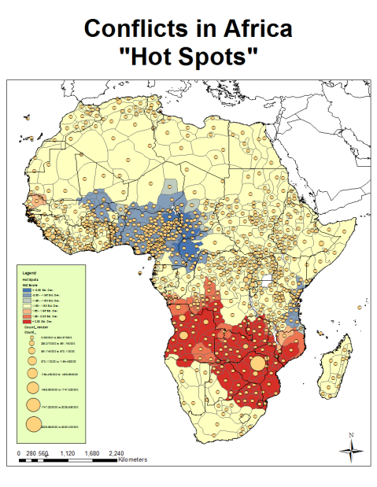
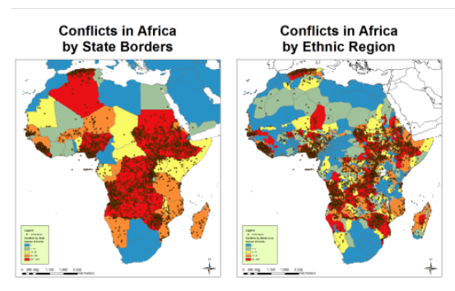
Ethnic Groups in Africa don’t recognize official borders
Some conflicts in Africa are ethnically motivated.
Other conflicts often occur near borders, rivers or state boundaries that are set by rivers.
https://peterslarson.com/2011/01/19/african-conflict-and-ethnic-distribution/

Slide 17
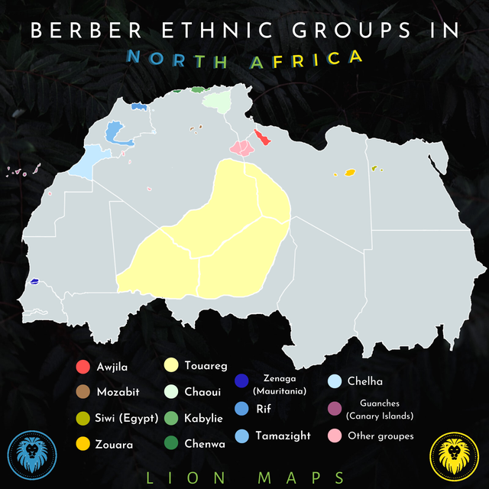
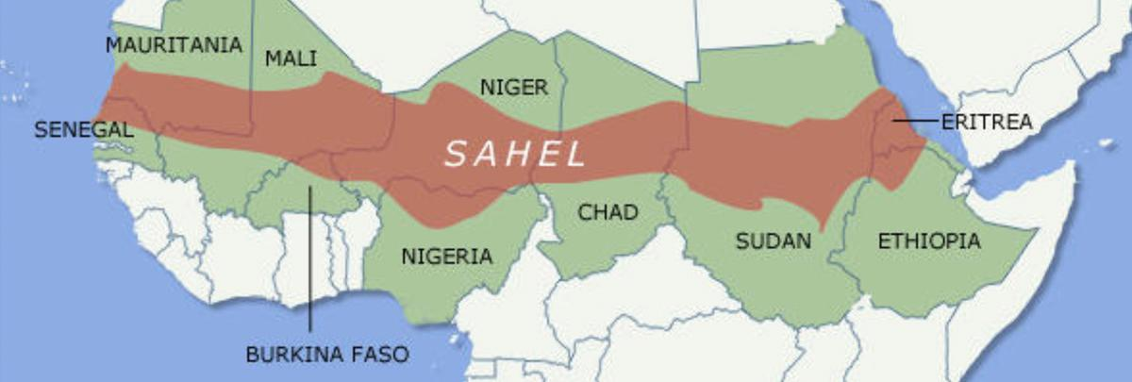
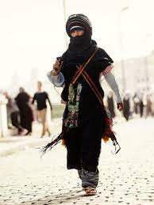
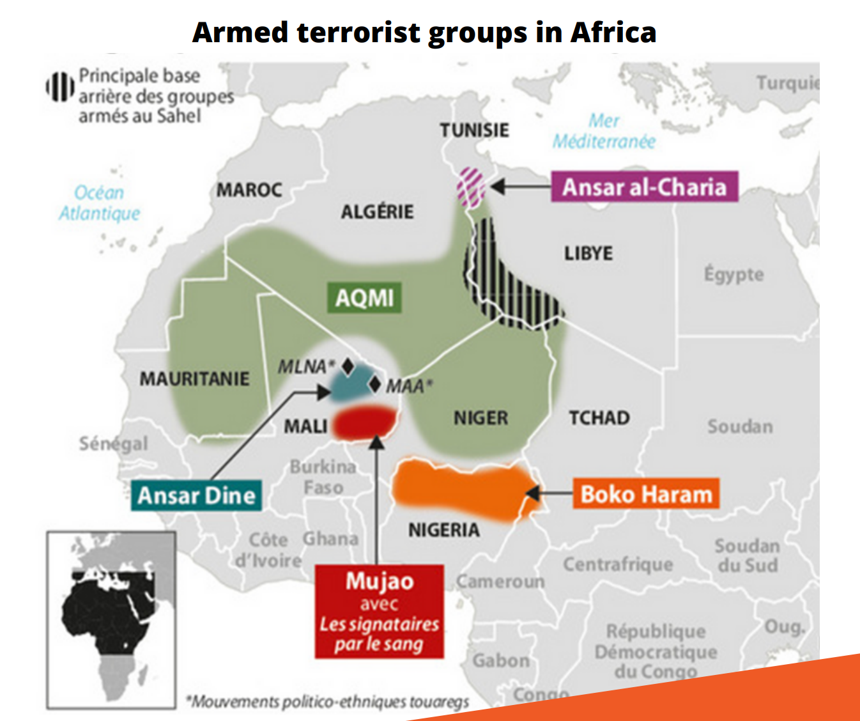
Tuaregs
The proliferation and abundance of arms from the international trafficking of small arms and light weapons in the Sahel and the Sahara region is a reality that has been widely exploited by several armed groups.

Slide 18
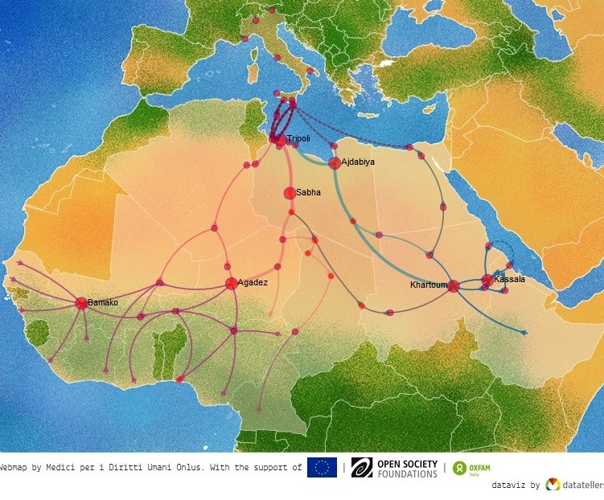
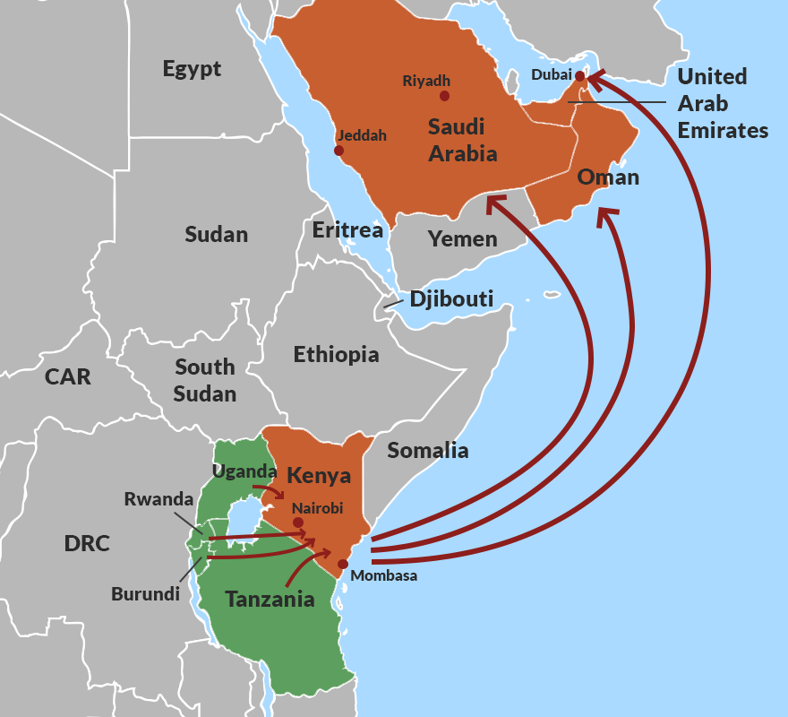
Human Trafficking
Main Migration Routes from Africa to UAE.
Victims not only from Uganda but also Burundi, Rwanda and to a lesser extent Tanzania. Most of East Africa’s trafficking takes place in and through Kenya. Girls victims of a well-established human trafficking ring in East Africa. Children are an easy target for smugglers and traffickers, for they are kidnapped, others are lured by smugglers with “no-fee” deals at the Eritrean border.
Main Migration Routes to Europe from Africa
Economic reasons are only indicated in 10% of the cases. African migrants escape from political or religious persecution. Torture. 9 out of 10 migrants say that they have seen someone been killed or severely hurt.
East African countries appear to lack power in negotiations with Middle Eastern countries on trafficking issues. This is because of gaps in their domestic legislation and regional trafficking strategies.
https://www.eepa.be/?p=1105
https://issafrica.org/iss-today/east-african-human-trafficking-rings-expand-their-operations

Slide 19
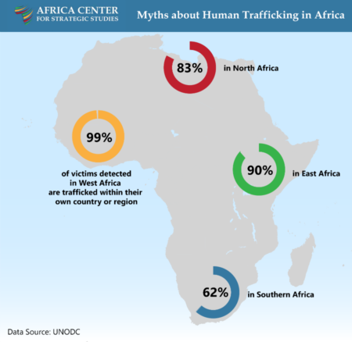
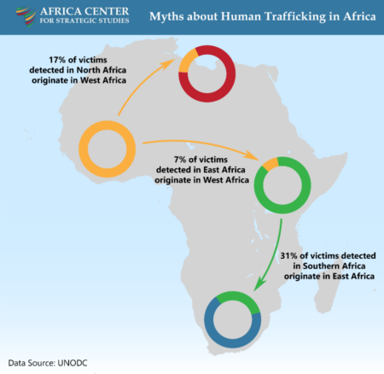
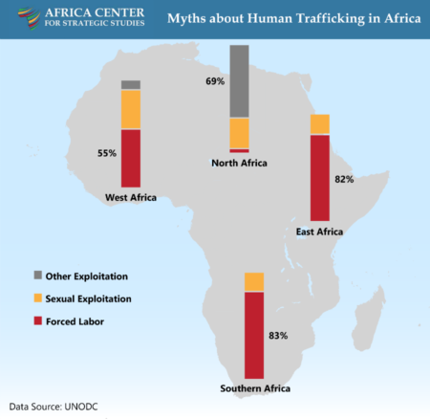
Human Trafficking
Currently, about 3.5 million Africans are being trafficked.
More women than men are trafficked in Africa.
Most African victims are trafficked into forced labor, often in fields such as agriculture, domestic service, and manufacturing.
More than 50% of trafficking victims in sub-Saharan Africa are children (mostly in West Africa).
17% of victims detected in North Africa are originated from West Africa.
Human trafficking involves taking control of people, through duplicity or force, for exploitation or economic gain.

Slide 20
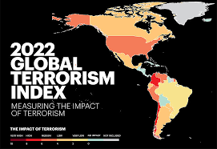
Terrorism in Africa
It seems that the evolution of the geopolitical context and the end of the Cold War have favored the replacement of Marxism by radical Islamism which, since September 11, 2001, has emerged as the new transnational ideology challenging the current world order.
Geo-political divisions are undermining international cooperation and a sense of impunity is taking hold in some countries in Africa.

Slide 21
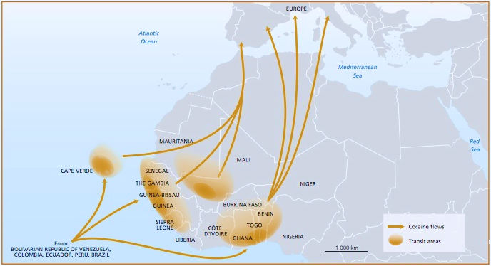
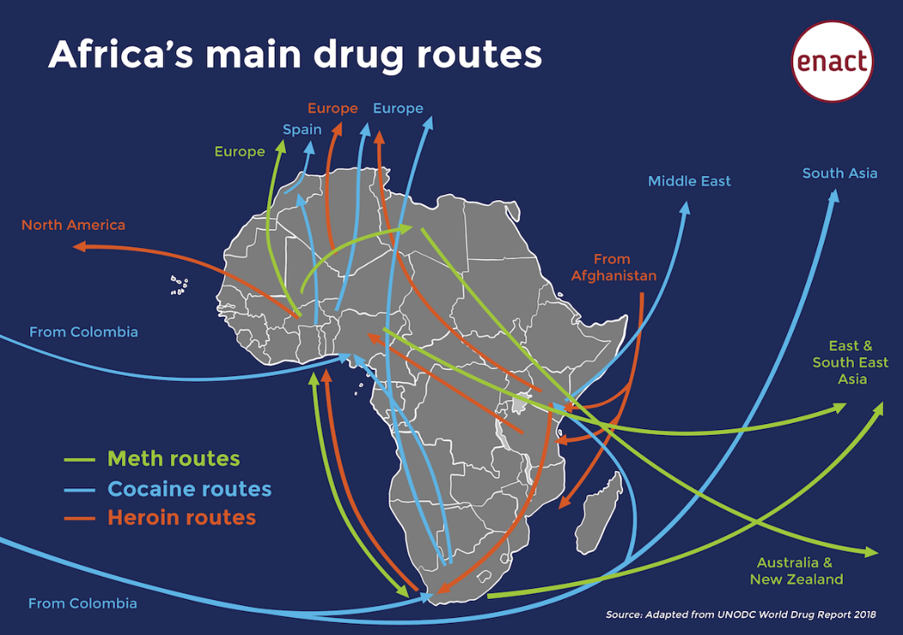
Drug Routes in Africa
According to the 2017 UN World Drug Report, two-thirds of the cocaine smuggled between South America and Europe passes through West Africa, specifically Benin, Cape Verde, Ghana, Guinea-Bissau, Mali, Nigeria, and Togo. Kenya, Nigeria, and Tanzania are among the countries that have seen the highest traffic in opiates passing from Pakistan and Afghanistan to Western destinations. Guinea-Bissau is a key transshipping point for drugs coming from Latin America.
AQIM (Al Qaeda in the Islamic Maghreb) and Jihad in West Africa, are involved in cannabis and cocaine trafficking in the Sahel.
Boko Haram has been implicated in cocaine and heroin smuggling across West Africa.
Trafficking pass trough Algeria, Mali, Mauritania and Morocco and then to southern Europe.
https://africacenter.org/spotlight/interdiction-efforts-adapt-drug-trafficking-africa-modernizes/
https://enactafrica.org/interactive/videos-and-infographics/africas-main-drug-routes

Slide 22
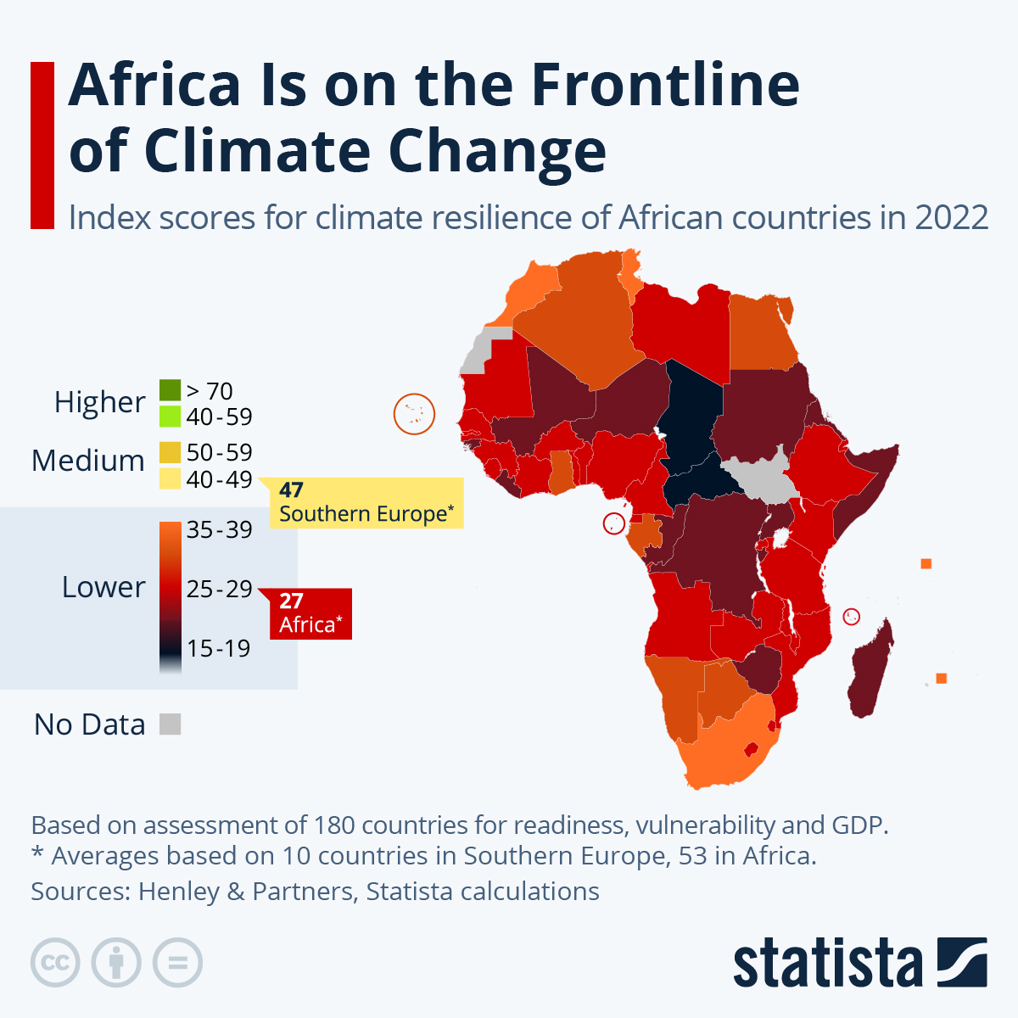
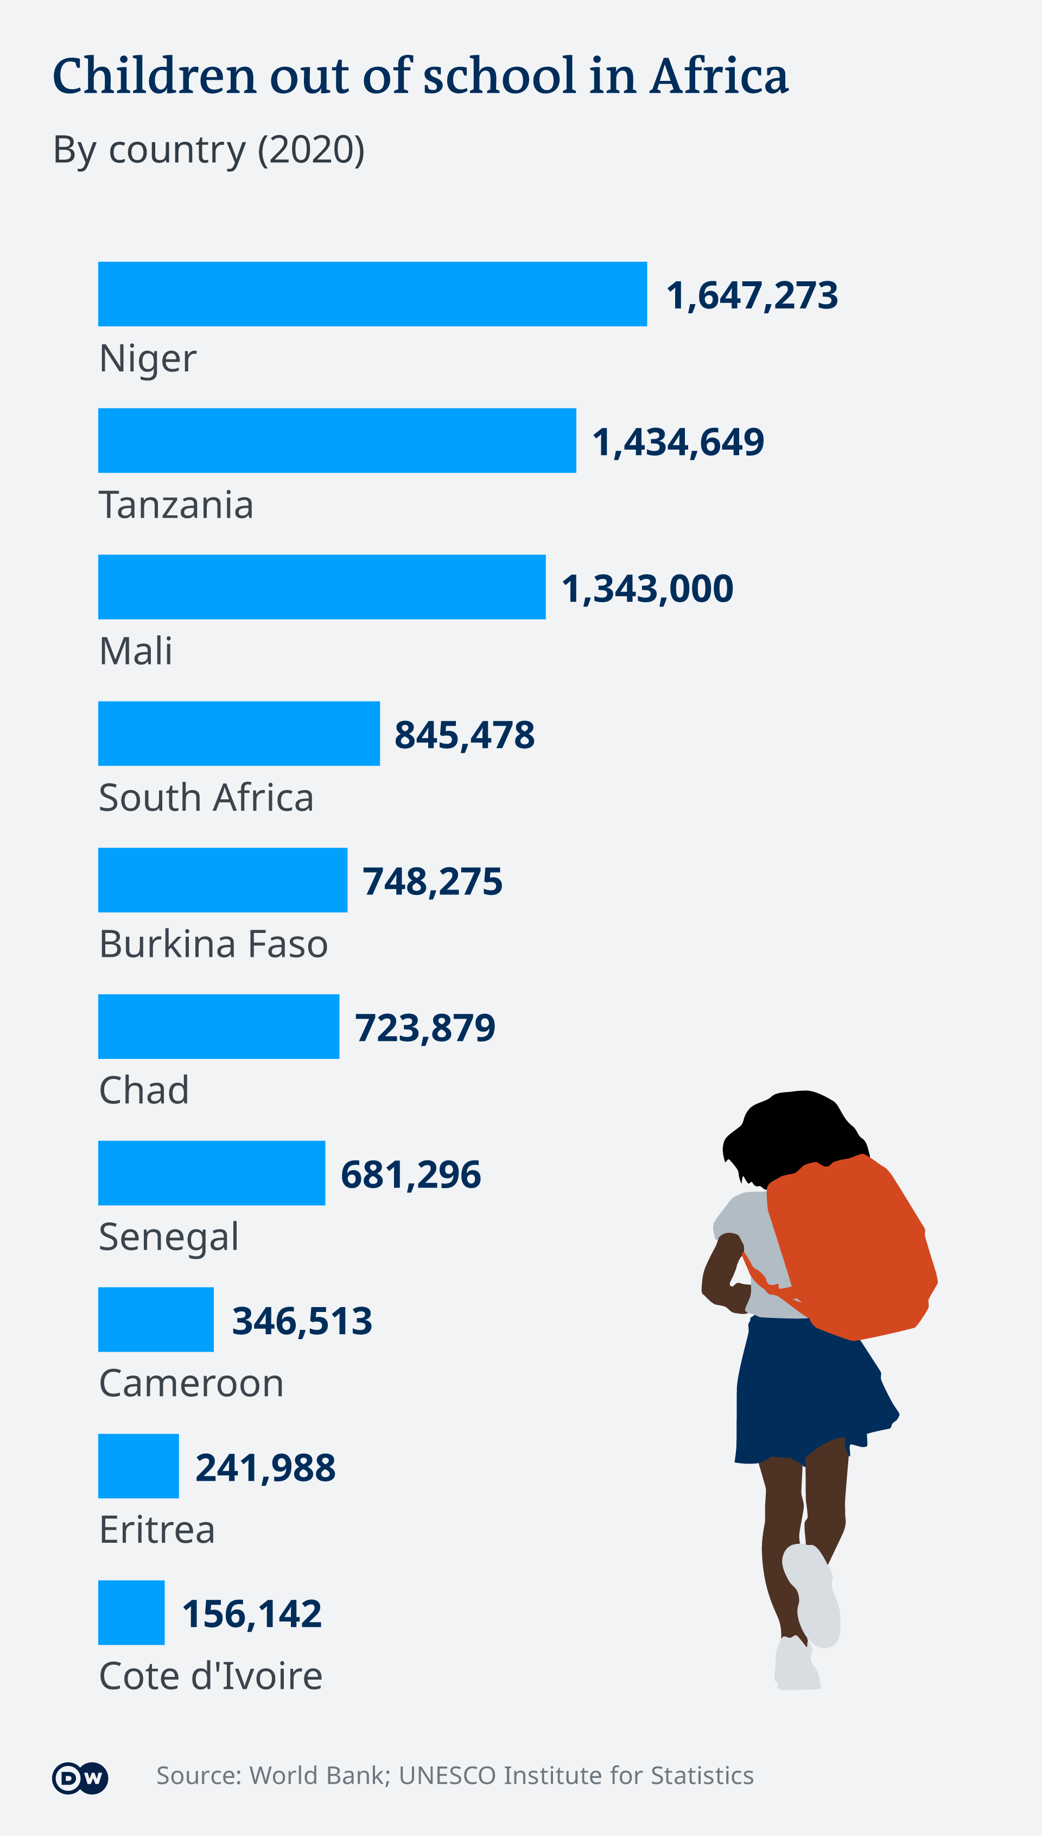
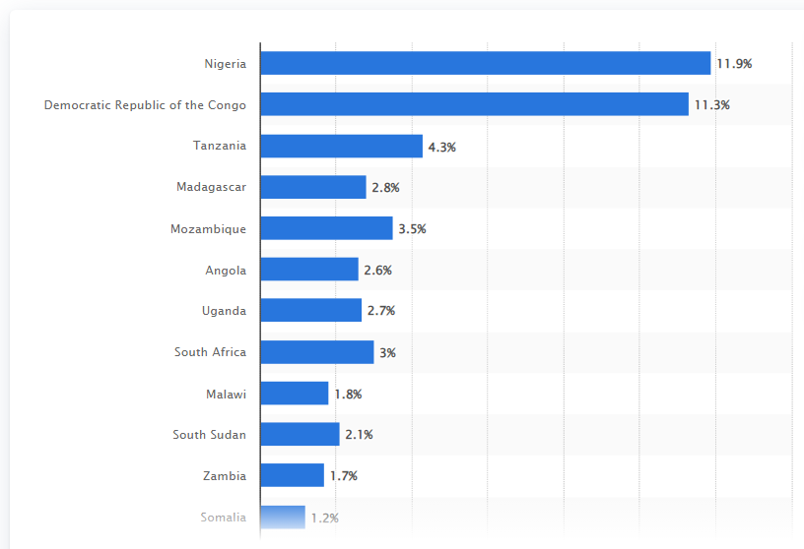
African countries with the highest share of global population living below extreme poverty in 2022
https://www.statista.com/statistics/1228553/extreme-poverty-as-share-of-global-population-in-africa-by-country/
https://www.economist.com/news/2007/06/19/sos

Slide 23
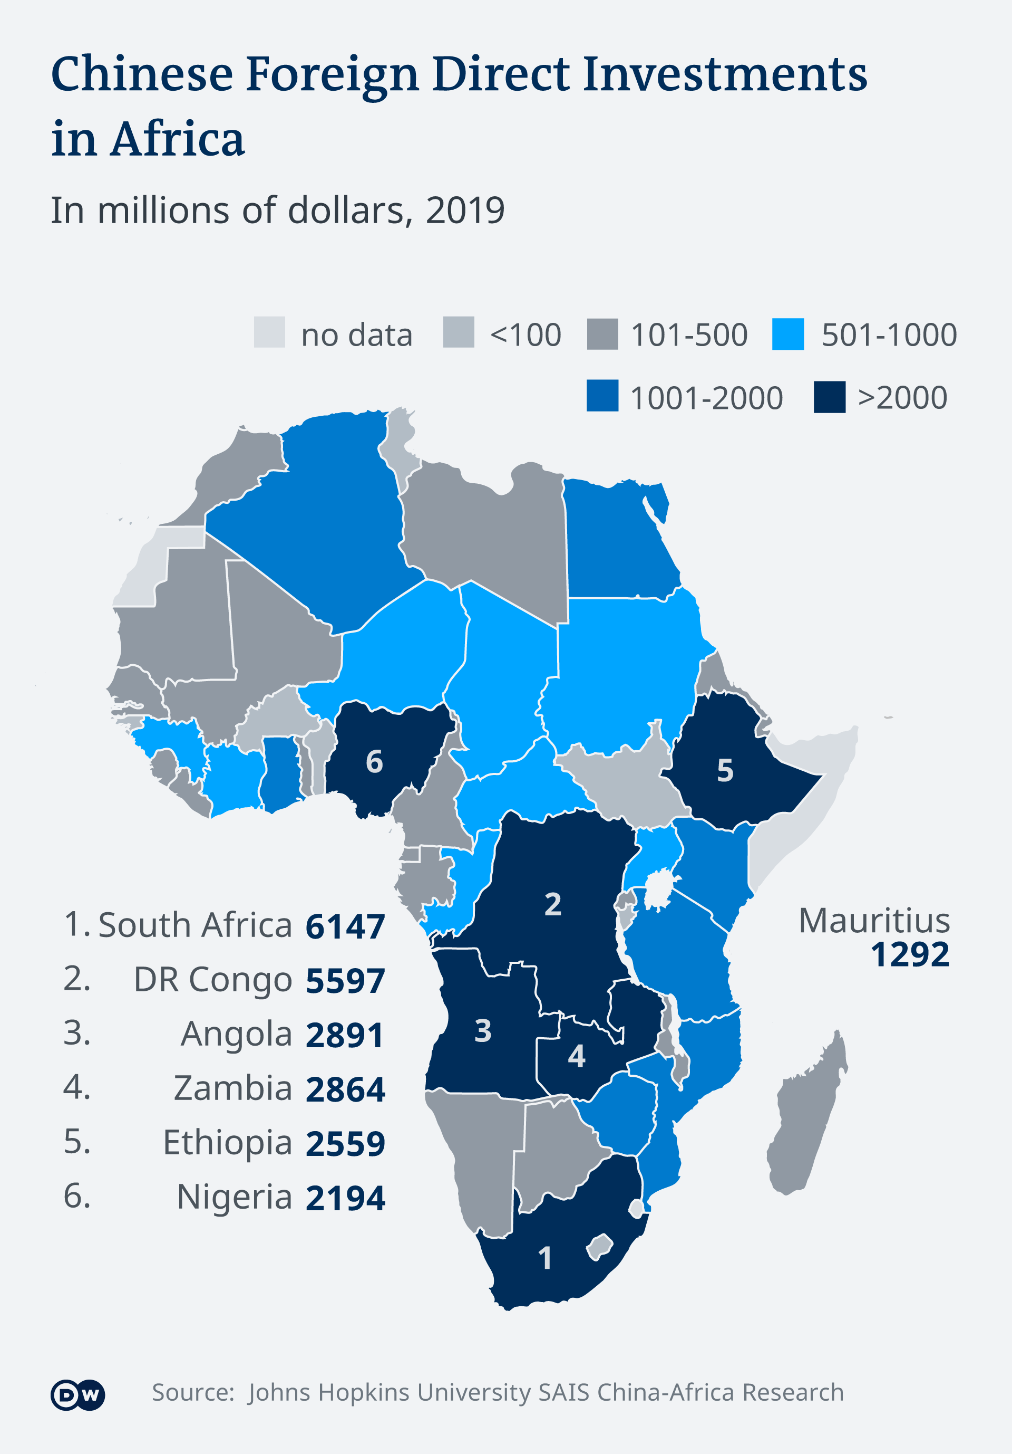
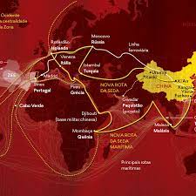
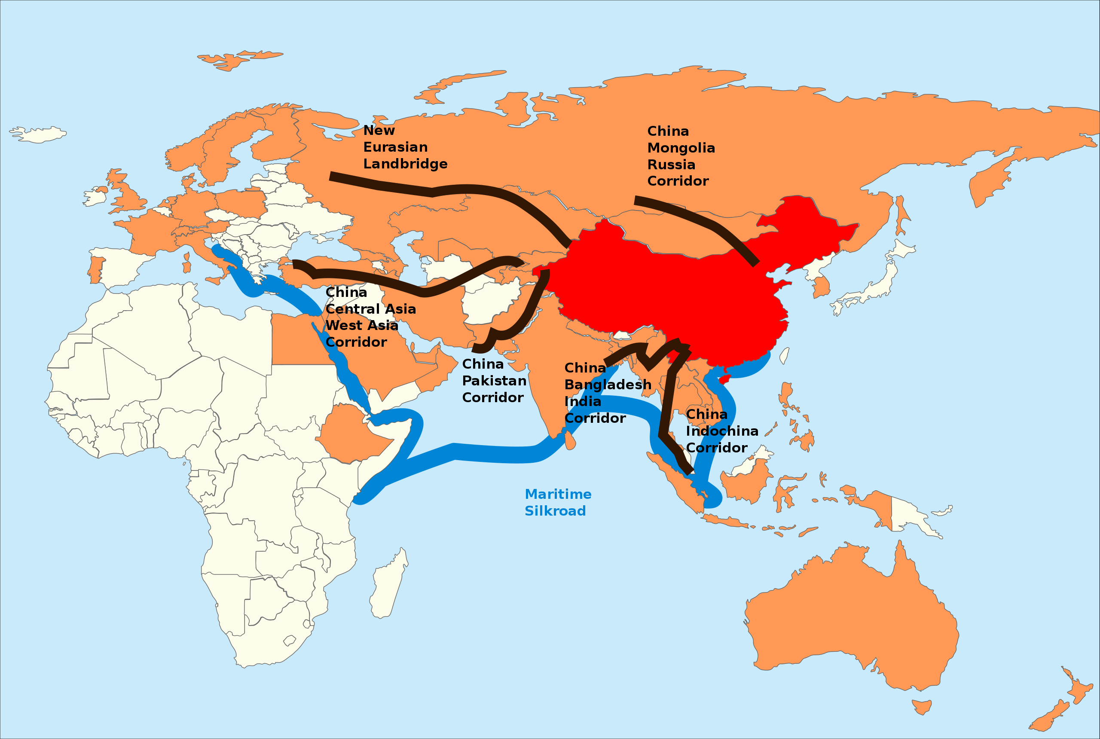
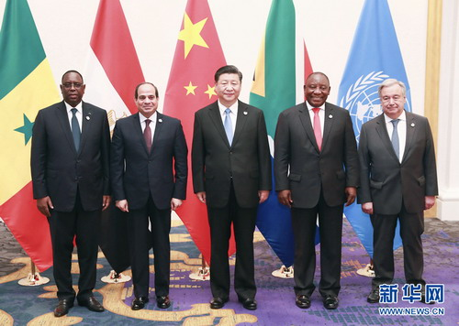
Power Competition in Africa by Big Foreign Players
China is Africa's leading trading partner and Africa's largest creditor.
The China’s One Belt, One Road Project (until 2050)
https://issafrica.org/iss-today/proceed-with-caution-africas-growing-foreign-military-presence
The shorter version, only including the northern-eastern side of Africa.
The Larger project, including Lusophony
On June 28, 2019. President Xi Jinping chaired the China-Africa Leaders' meeting in Osaka. South African President Cyril Ramaphosa; Egyptian President Abdel-Fattah al-Sisi, also rotating chair of the African Union (AU); Senegalese President Macky Sall, current African co-chair of the Forum China-Africa (FOCAC); and Secretary-General of the United Nations (UN) António Guterres.

Slide 24
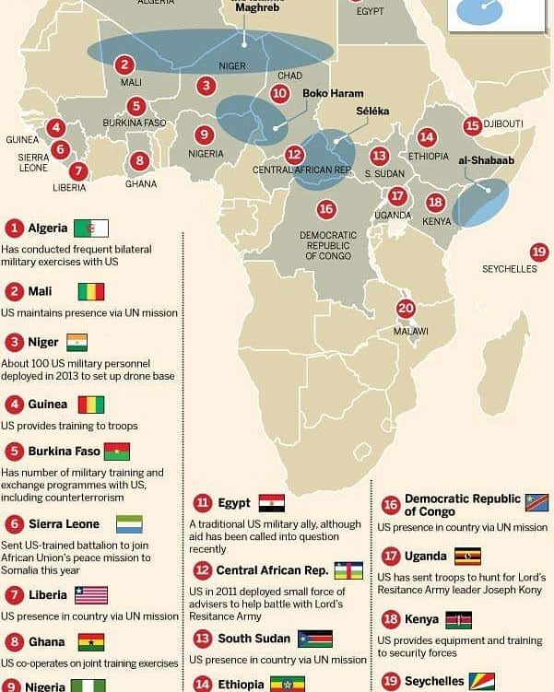
Power Competition in Africa by Big Foreign Players
The United States of America has 34 military bases in Africa.
«The US has numerous military outposts in Africa from where it conducts drone operations, training, military exercises, direct action and humanitarian activities. The associated infrastructure, support systems and military personnel for these operations have amounted to significant American interest in Africa.»
«The US military justifies its presence in Africa with its need to protect those interests, despite the risks to host countries. Such reinforcement won’t allow for any significant downscaling of military presence in the near future, regardless of the gains made in fighting terrorism.» (Andrews Atta-Asamoah, 2019)
https://www.facebook.com/USAfrika.gov/photos/a.1290257117778098/2158581747612293/?type=3

Slide 25
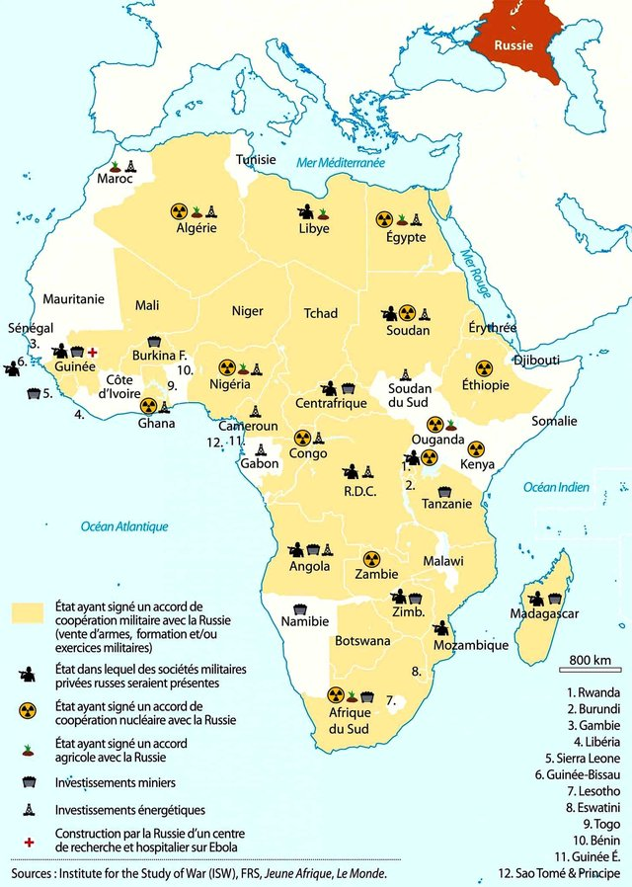
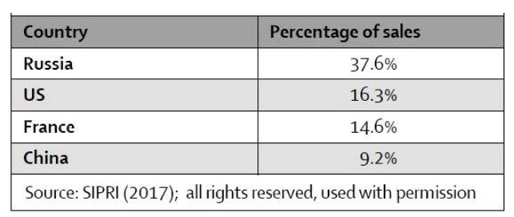
Power Competition in Africa by Big Foreign Players
Russian presence in Africa
2019
Top Arms’ suppliers to Africa (2017)
«Putin attaches great importance to rebuilding Russia as a world power, including relations with Africa. But while the Soviet Union used to advocate socialist modernization in Africa, Moscow no longer offers socialist ideologies. Instead, it focuses on access to African elites, particularly authoritarian leaders. It also seeks to sway elections in its favor, particularly in fragile, but resource-rich states. The Kremlin says it wants to avoid competing directly with other powers active in Africa. (…) But Russia, like China, is challenging Western norms, undermining US and EU sanctions. In addition, both strategic partners support non-interference in the internal affairs of states. In addition, Russia's relations with Africa have been motivated significantly by its interest in African resources and security markets. Russia's resurgence in Africa benefits from Islamist terrorism (for example, in the Sahel and Mozambique). It uses fragile states and ongoing conflicts to secure lucrative arms deals and mining concessions. Moscow signed military cooperation agreements with 21 African governments, including negotiations on establishing military bases. It uses paramilitary contractors to manipulate the course of local conflicts in its favor. Since 2015, Russian-African trade has doubled to around USD 20 billion per year. Russia exported $14 billion worth of goods and services and imported about $5 billion worth of African products.» (Dirk Kohnert, 2022)
https://www.researchgate.net/publication/359082956_The_impact_of_Russian_presence_in_Africa/figures?lo=1

Slide 26
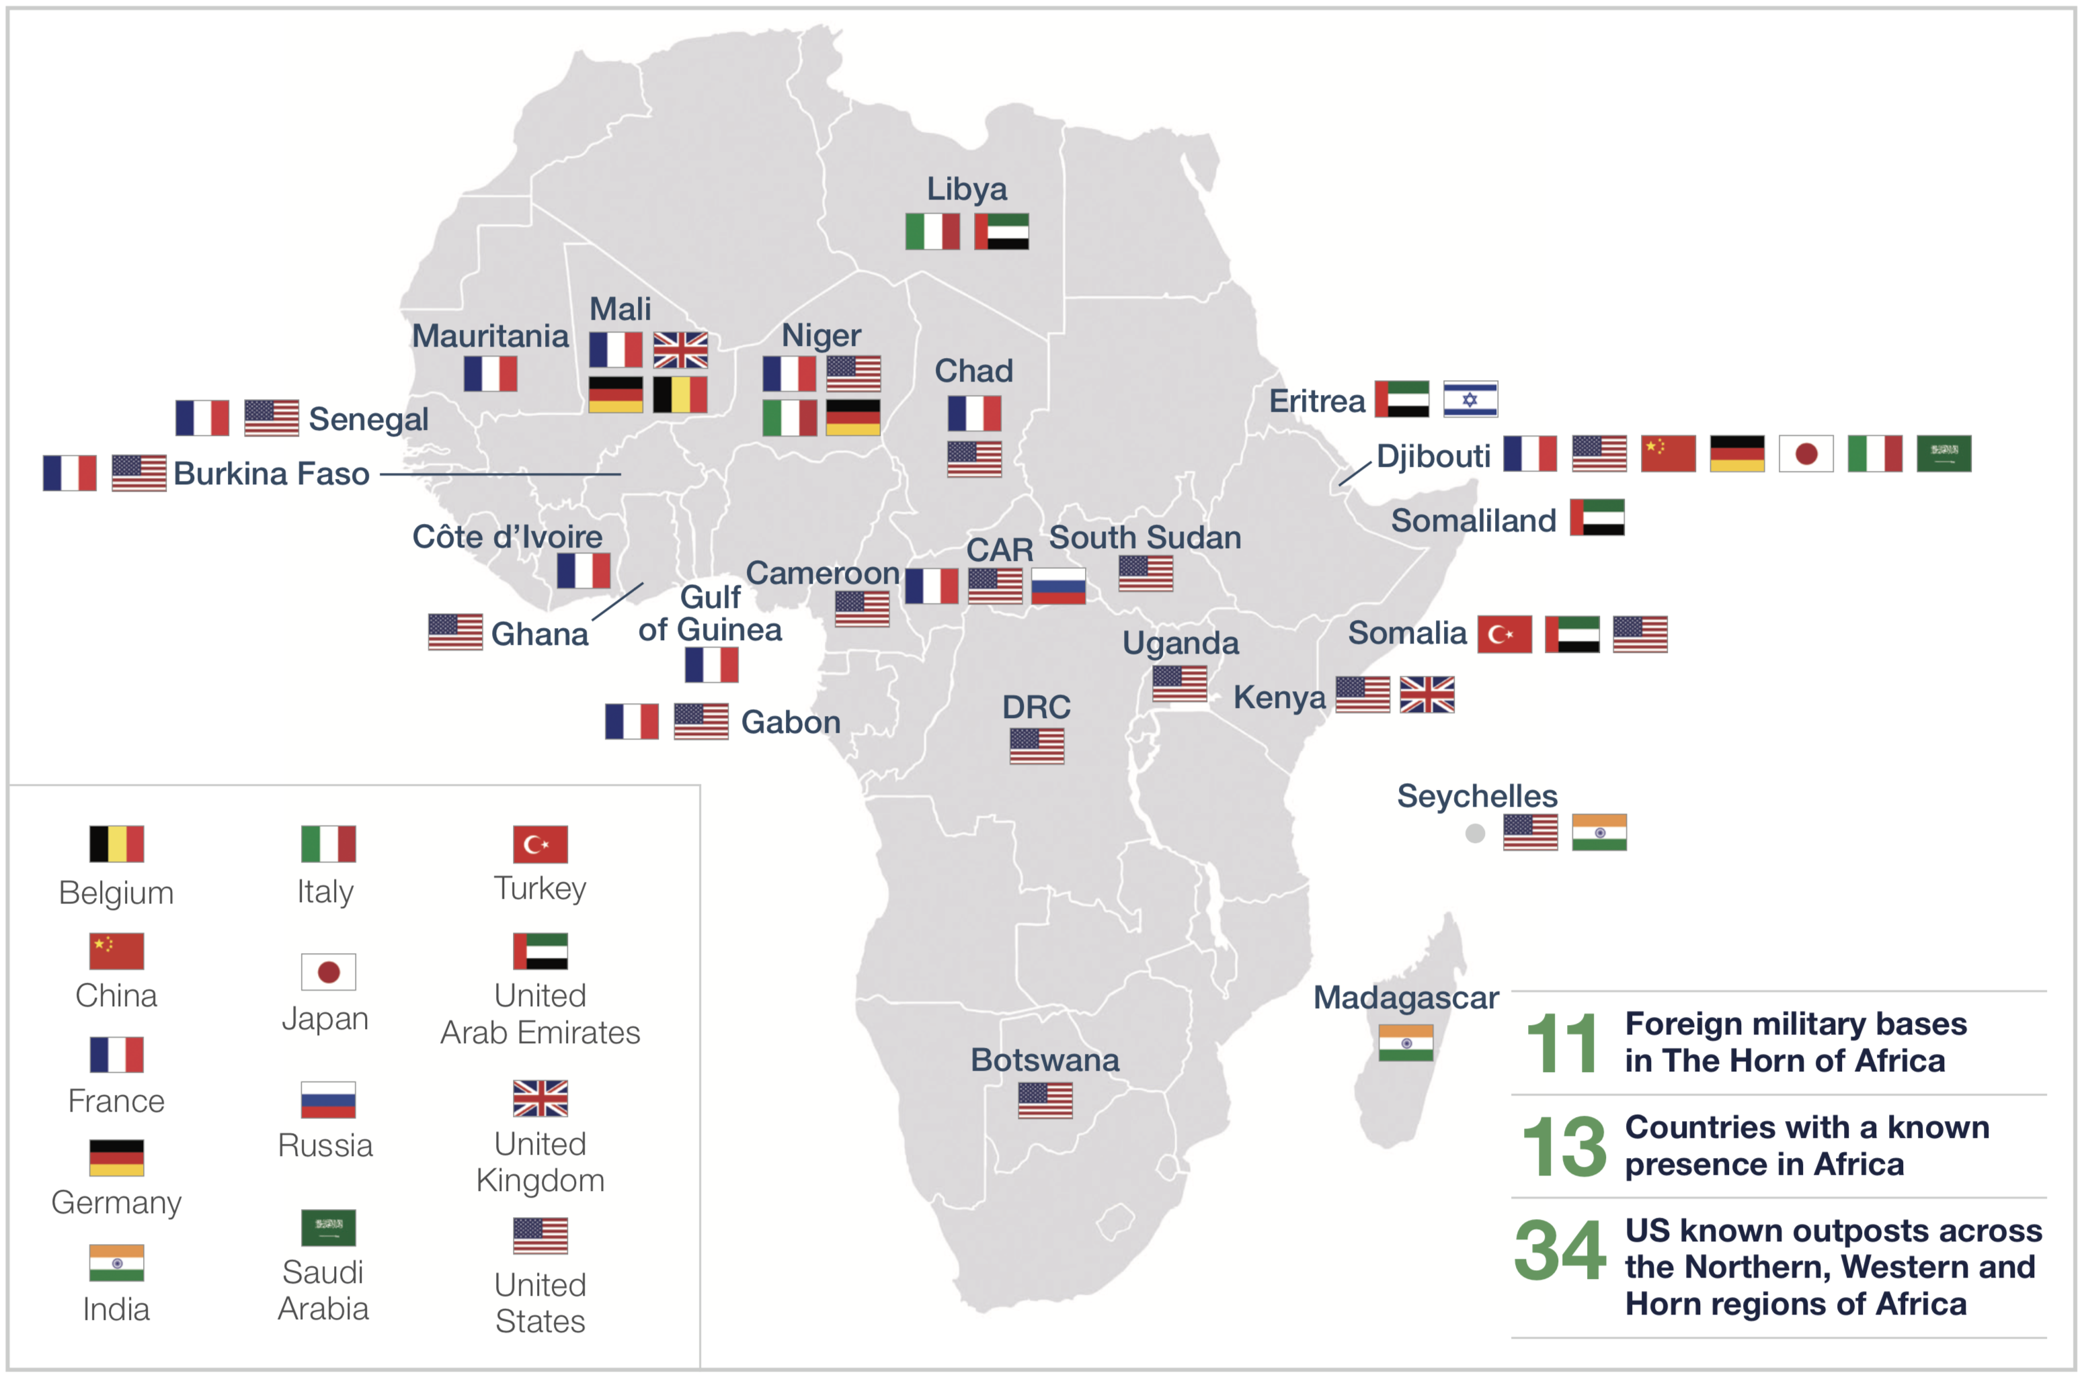
2019
Power Competition in Africa by Big Foreign Players
Bilateral relations
Multilateral relations, through African Union.
«Africa is host to a rising number of foreign military operations and bases, largely due to bilateral agreements between some African Union (AU) member states and foreign powers.»
«Of the 13 countries with a known presence in Africa, the United States (US) and France have the most troops on the continent. (…) France has an estimated 7 550 military personnel spread across the continent in various military operations and missions (excluding UN operations). The US has a higher number spread across 34 known outposts across the Northern, Western and Horn regions of Africa.»
«The Horn of Africa has become the epicenter of this presence, with about 11 foreign military bases. This is largely due to the region’s strategic proximity to the Middle East and Asia and the subsequent threats along the Red Sea.» (Andrews Atta-Asamoah, 2019)
https://issafrica.org/iss-today/proceed-with-caution-africas-growing-foreign-military-presence
https://issafrica.org/iss-today/proceed-with-caution-africas-growing-foreign-military-presence
«The increasing presence of Asian powers in Djibouti points to another major risk. Following China’s expanding presence in the country, there are growing fears in Japanese and Indian circles regarding Chinese influence in the Indian Ocean. The result is expansion of Japanese influence in Djibouti.»

Slide 27
Conflict prevention dynamics. Prospects for the future of the African continent.
AFRICA
Domestic problems.
The gaps in Africa’s responses to its peace and security challenges are because of the continent’s inability to swiftly operationalize the “African Peace and Security Architecture”, particularly its “African Standby Force” component, which would help contain crises.
Foreign military presence in Africa is also driven by AU member states leasing their territories to foreign powers for military bases, mainly for domestic economic gain. This is also sometimes driven by member states seeking external help in dealing with serious security challenges.
Dealing with African problems:
Regional response structures such as the Joint Force of the Group of Five of the Sahel (G5 Sahel) and the Multinational Joint Task Force.

Slide 28
Muito Obrigada!
Thank You!
Maria Sousa Galito
Assistant Professor at the Lusiada University of Lisbon.
Researcher at the CEJEA of Lusíada University of Lisbon.
Researcher at the CESA-CSG of ISEG, University of Lisbon.

